Slide 1
COSC TEAM 14
Internship Project Submitted to COSC

Slide 2
Staff Leave application
Mentored by: Hruday Tej
Android team
Snigdha
Aryaman
Pardha saradhi
Django team
Dinesh
Varsha
Api team
Surya
Abhay

Slide 3
PROBLEM STATEMENT
Users
•Login and registration
•Apply for leave
•Check leave history
Hod
•Login and registration
•Check and modify leaves
•Attendance tracking

Slide 4
TECHNOLOGY USED
Mysql for database
Android studio for app
Django for web framework
Flask Restapi for api’s

Slide 5
DATABASE
A database is a collection of information that is organized so that it can be easily accessed, managed and updated
Simple Database and also provides all the facilities required for our project.
Features of our database:
Have different tables to store information of hod as well as employee
Have tables which help employee access to apply for leave as well as check their status and also where hod can check the leave application and update the status
We restricted ourselves to keeping schema manageable and also well classified

Slide 6
FLASK API WITH JWT
Flask is able to achieve generally faster performance than Django
An API is an abstraction, it groups system calls together to make it easier
JWT allows user to access routes, services, and resources that are permitted with that token

Slide 7
ANDROID
ANDROID
We used android studio to create it
It contains a login and a registration page.
After logging in they can either apply for a new leave or check the details of all their previous leave applications
Staff members can also edit their details which were given during registration

Slide 8
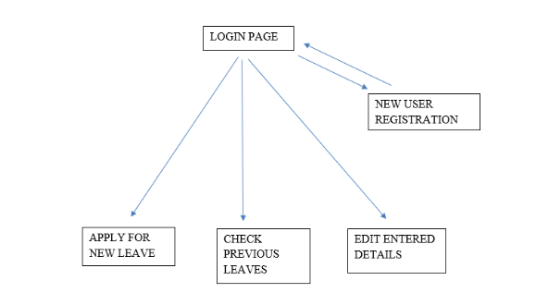

Slide 9
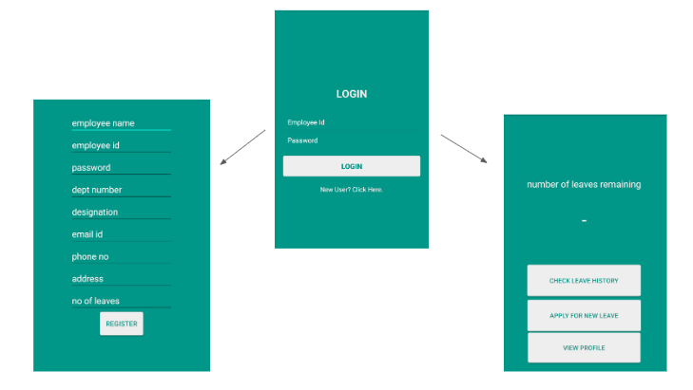

Slide 10
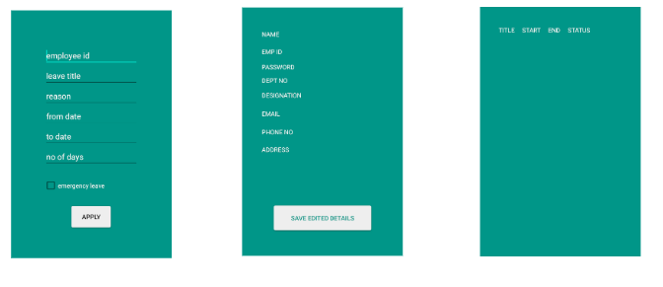

Slide 11
DJANGO
“Django” frame-work is used for making a web-application
Each department head can login after registering with their information
And then after logging in successfully they can view the following things:
Home page where all the department heads information is displayed
Profile page with information of the HOD
Leaves page where all the leaves applied by the staff are displayed in a table
About page with more info of user and also an edit option is change the number of leaves left
Calendar to track the attendance of employee and Option for resetting the password are also included

Slide 12
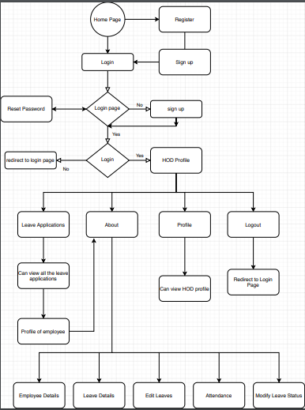
FLOW DIAGRAM FOR DJANGO PART

Slide 13
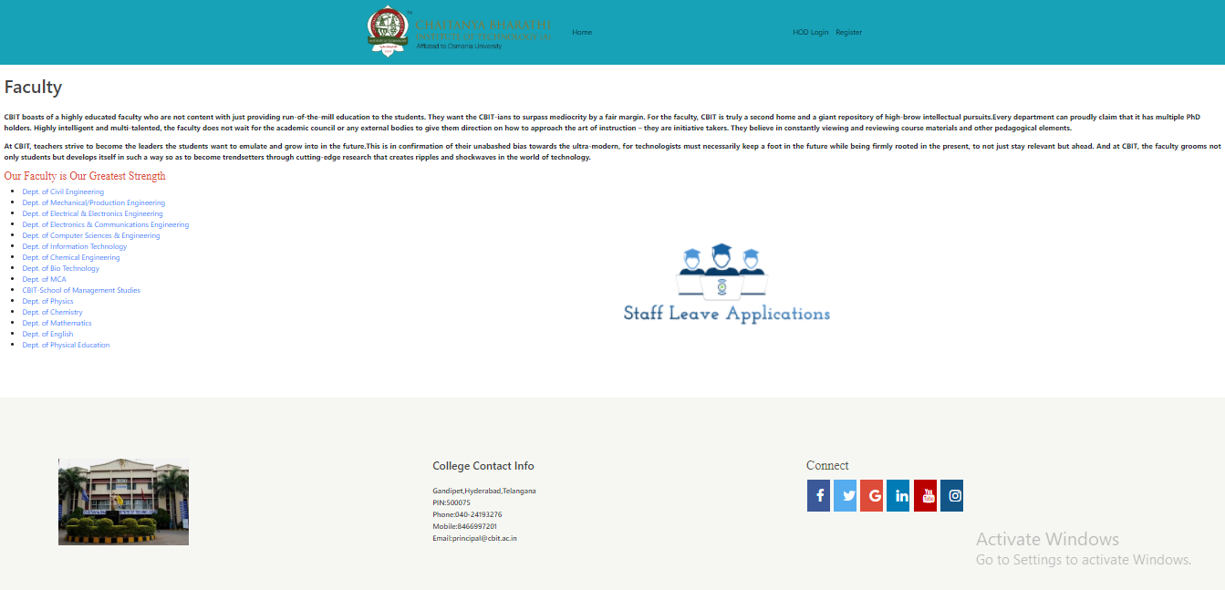

Slide 14
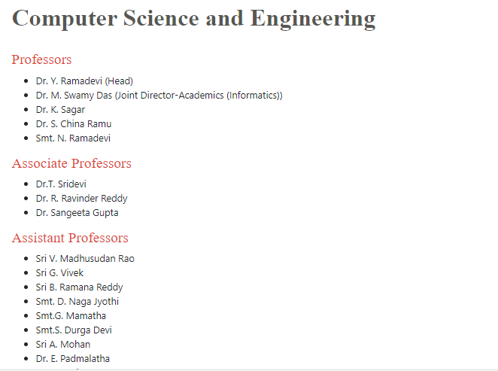
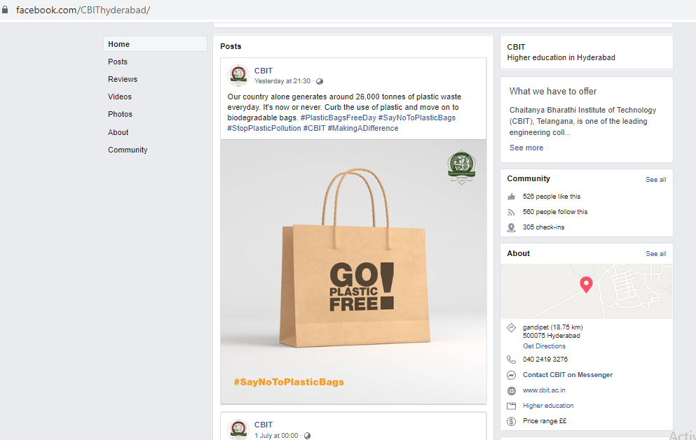

Slide 15
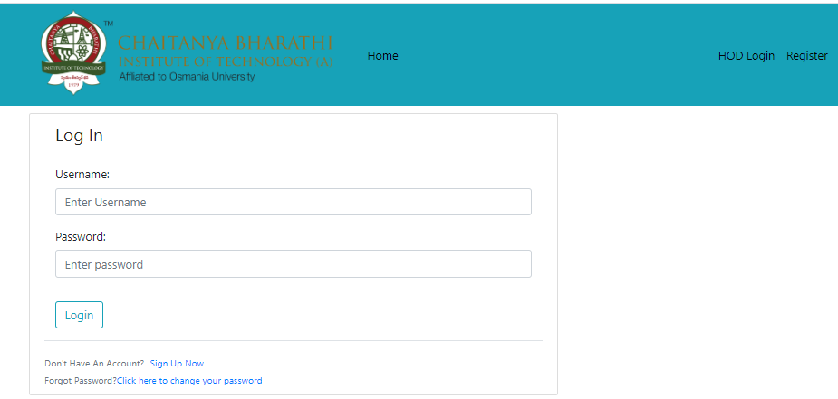
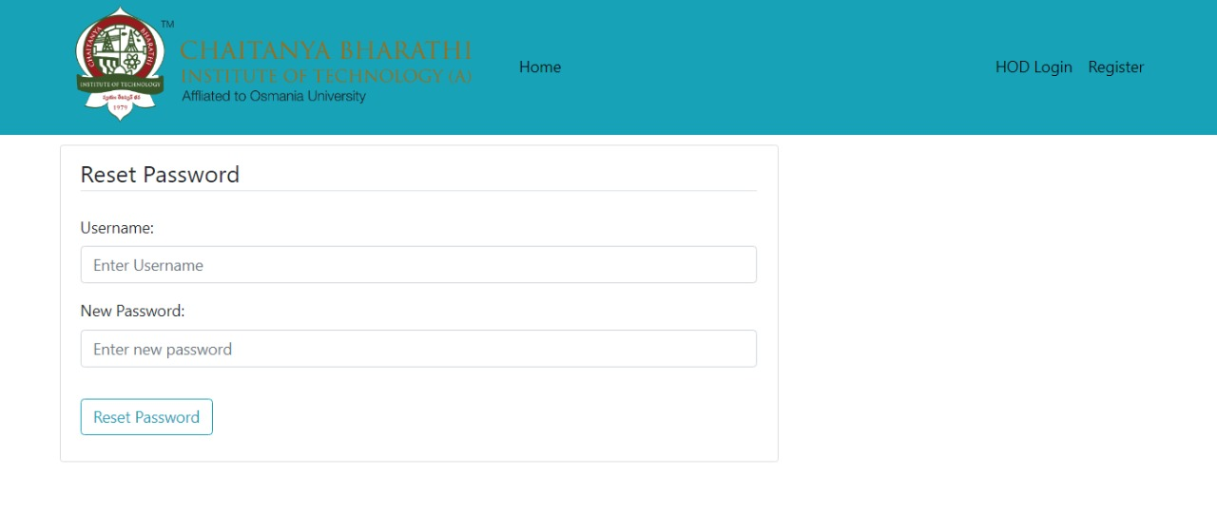
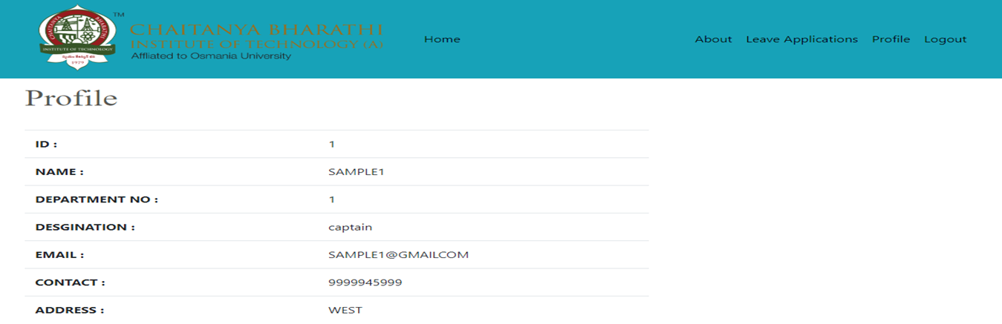

Slide 16
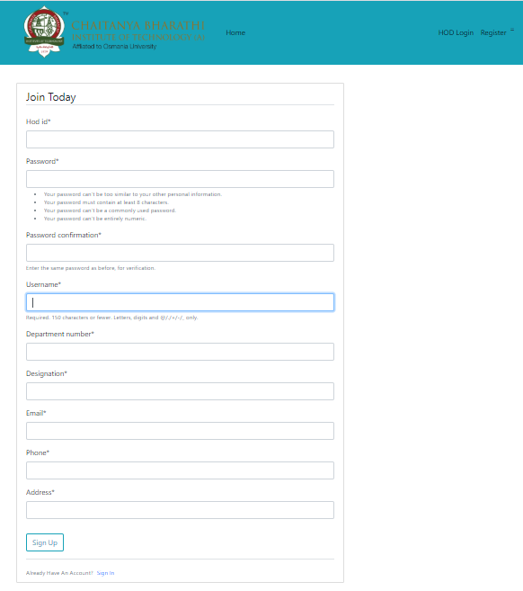

Slide 17
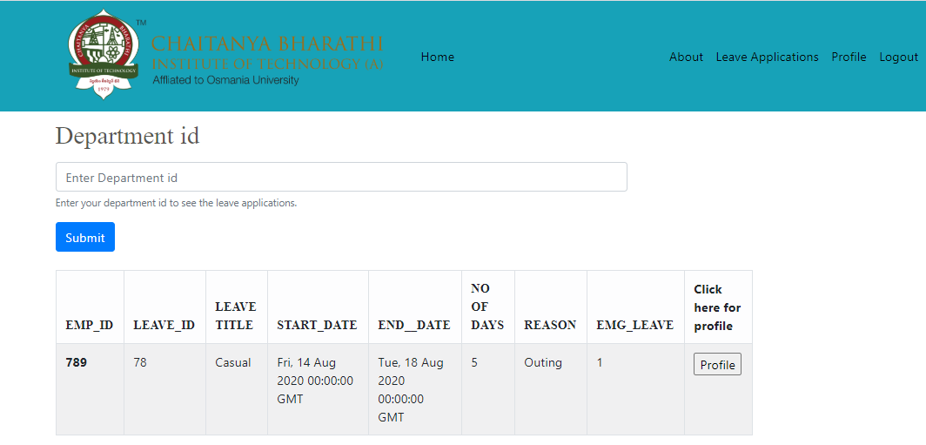
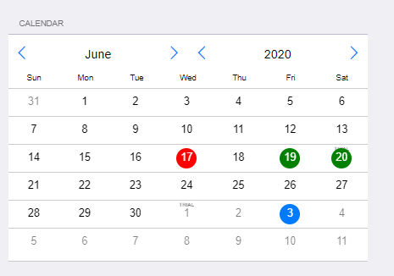

Slide 18
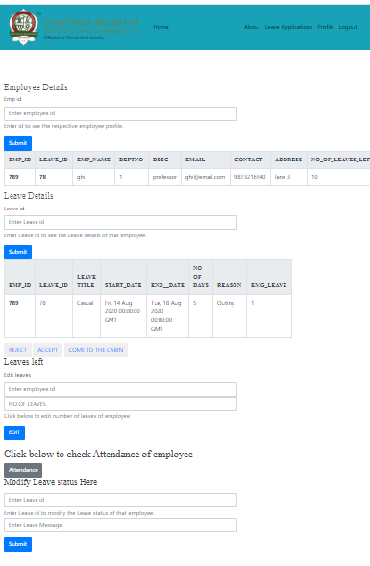

Slide 19
THANK YOU

Slide 20
ANY QUESTIONS

